Slide 1
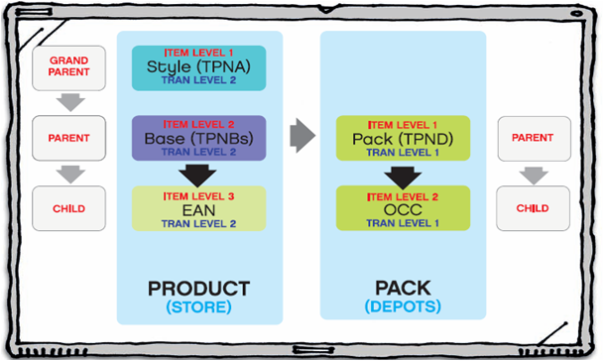









Product Setup
Price Change
Supplier Deals
Clearance
ORIB Overview
By –
RK

Slide 2
Agenda
1. What is ORIB and why required?
2. Oracle Retail Architecture
3. Seebeyond e*Gate Components
4. ORIB Architecture
5. Publisher Adapter
6. Subscriber Adapter
7. TAFR Adapter
8. RIB for RPM & Jar Files
9. RIB Hospital & Log files
10. Common RIB Issues & Solution

Slide 3
ORIB (Oracle Retail Integration Bus)
ORIB as part of the Oracle Retail solution are responsible for synchronizing data between Oracle Retail applications like ORMS, ORWMS, ORPM and SIM and also legacy systems and third party applications
ORIB synchronises data asynchronously
  Messages will be published in JMS (Java Messaging Service) topic and subscribers will subscribe the messages from JMS Topic.
  Retek 12 version uses Seebeyond e*Gate(ver 5.0.5) EAI platform for storing messages into JMS topic.

Slide 4
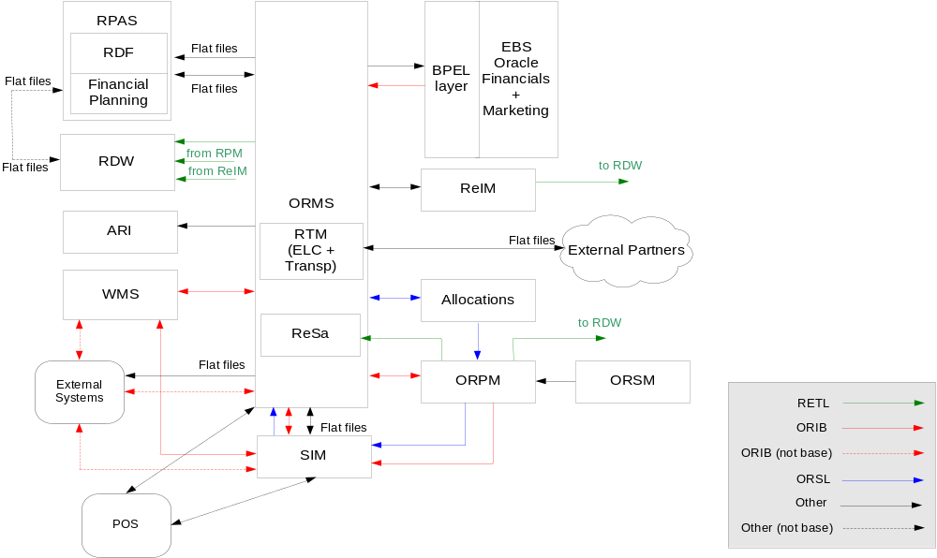
Oracle Retail architecture

Slide 5
Seebeyond e*Gate Components
Registry - A Registry is a file-based database defining the deployed EAI system and a program that controls access to this database. A Registry is organized into one or more Schemas. This also contains basic security objects that control user identifications, roles, and privileges shared across all schemas.
Schemas - Each schema details a collection of e*Ways, Intelligent Queue Managers, Intelligent Queues, Connection Points, and Collaboration Brokers along with their network addresses or locations.
Control Brokers - The control broker is responsible for maintaining the operational control and status of its attached components. Another goal of a control broker is to minimize the number of network connections to the registry and to provide a central point of control for a set of components. Each control broker connects to one registry but can also fail over to other registries if needed.

Slide 6
Seebeyond e*Gate Components - contd
Events and Event Type Definitions- SeeBeyond “events” include both messages passing to and from JMS, and stored procedure calls to external application APIs. An event’s type determines its logical name, but the rules for parsing are determined by an event type definition (ETD). Hence, the ETD has a strong coupling with the message structure.
Collaborations - Collaborations define message processing logic on a per Message Family/message source/ component combination. This logic is “triggered” or executed when the adapter pulls a message with the correct event type from the specified source.
e*Ways – This adapter produce, consume, or otherwise process messages. e*Ways contain one or more “Collaborations” that are triggered from some event. A collaboration works on a collection of input and output events, which may be messages going to or from queues.

Slide 7
Seebeyond e*Gate Components - contd
JMS Intelligent Queues - Java Messaging Service (JMS) IQ hold published messages and maintain a record of what subscribers have received the messages.
JMS IQ Managers - The JMS Intelligent Queue Manager serves two roles. To control a set of Intelligent Queues for any SeeBeyond e*Way. The second (which the RIB uses) is to act as a Java Message Service (JMS) provider, accessible through JMS Connection Points. The RIB is designed to only retrieve and publish messages to a JMS compliant server. The preferred JMS implementation is the SeeBeyond’s standard JMS implementation. The RIB uses JMS topics instead of queues to allow all subscribers to the topic to receive a copy of the message depending on the matching of the subscriber’s message selector and message’s properties.
e*Way Connection Points – An “e*Way Connection” or “Connection Point” defines a session between the e*Way and an external system. The following types of connections are available:
- Java Message Service – a connection to a JMS Server or JMS Service.
- A relational database, such as Oracle
- A TCP/IP connection to a remote application using the HTTP or HTTPS protocol.
- E-mail (uses standard SMTP for outbound and POP3 interfaces for inbound messages)
A database connection point used within a collaboration defines the login, password, and server address for database operations.

Slide 8
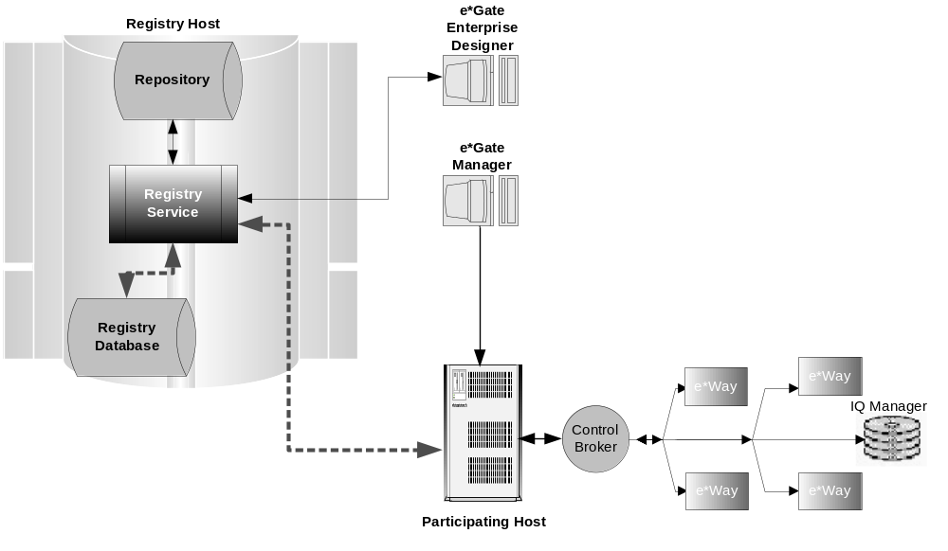
ORIB Architecture

Slide 9
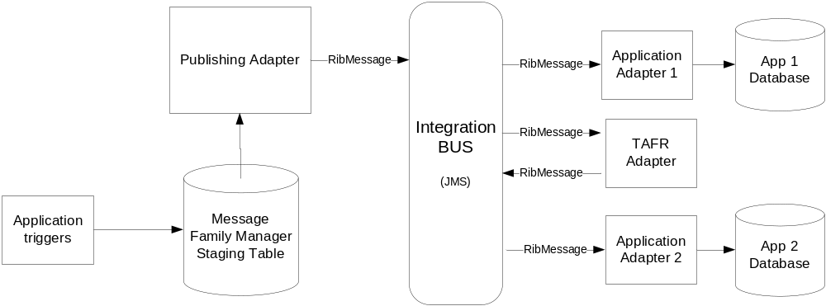
Outbound Eway – Publisher Adapter
  eWay makes a call to the message family manager (RMSMFM_ITEMS.GETNEXT() procedure) to get the message to publish.
  The message family manager will construct the message into Oracle Object and send it to eWay.
  The eWay converts the Oracle Object Type to XML by pubtrans(Eg. ItemsObjectTranslator.java) and publishes a RibMessage, with the message payload;
Notes:
Talk about the Life cycle of a product and explain the below terms
Item
Supplier
Warehouse
Store
Price
Cost
Promotion

Slide 10
Inbound Eway – Subscriber Adapter
Subscriber Adapter ( Inbound eWays)
  Takes the payload from the RibMessage and converts it to Oracle Object Type.
  Makes a call to the appropriate PL/SQL consumer package( eg RMSSUB_XITEMB.CONSUME() with message, message type).
  The Subscriber package converts Oracle Object into PL/SQL variables.
  The records are validated and then inserted into the final tables or staging tables.
Notes:
Talk about the Life cycle of a product and explain the below terms
Item
Supplier
Warehouse
Store
Price
Cost
Promotion

Slide 11
Inbound Eway – TAFR Adapter
TAFR Adapter
  Transform Address Filter/Router
  Transform between different message formats, (ex: Transfers to Stock Orders);
  Message Routing, depending on the message contents, or conditions that can be checked against the RibMessage Routing info section (ex: item routing per WH);
Notes:
Talk about the Life cycle of a product and explain the below terms
Item
Supplier
Warehouse
Store
Price
Cost
Promotion

Slide 12
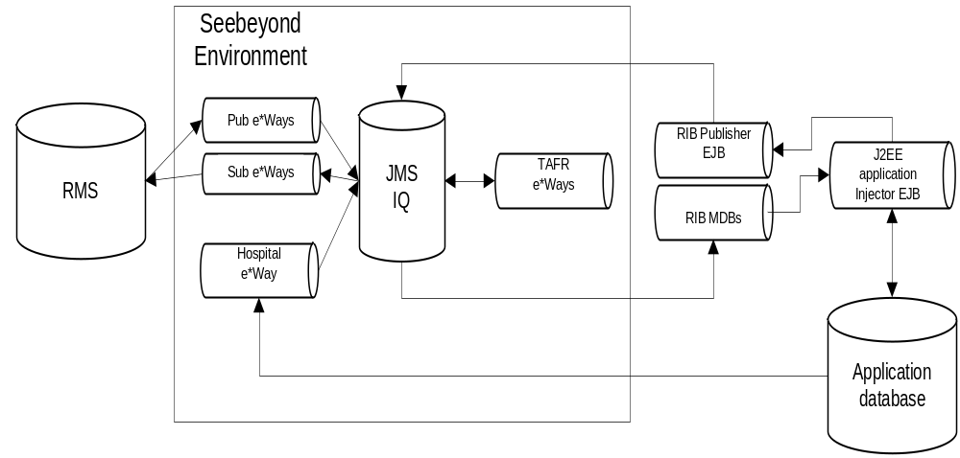
ORIB-RIB for RPM
Architecture
  ORMS >> Application (ex : ORPM) – MDB
  Application (ex : SIM) >> ORMS - SSB
Notes:
Talk about the Life cycle of a product and explain the below terms
Item
Supplier
Warehouse
Store
Price
Cost
Promotion

Slide 13
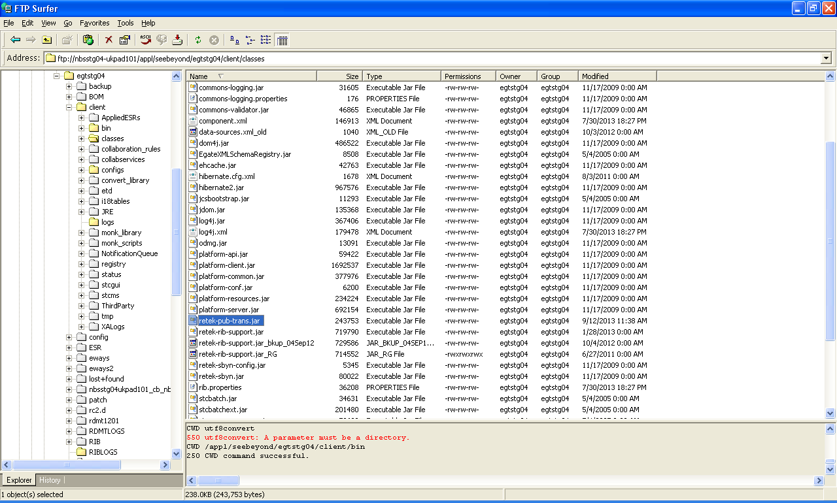
RIB Jars
Notes:
Talk about the Life cycle of a product and explain the below terms
Item
Supplier
Warehouse
Store
Price
Cost
Promotion

Slide 14
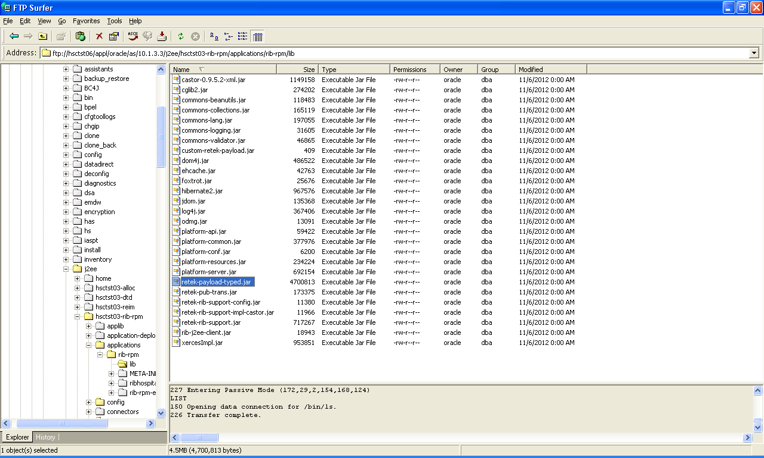
RIB for RPM Jars
Notes:
Talk about the Life cycle of a product and explain the below terms
Item
Supplier
Warehouse
Store
Price
Cost
Promotion

Slide 15
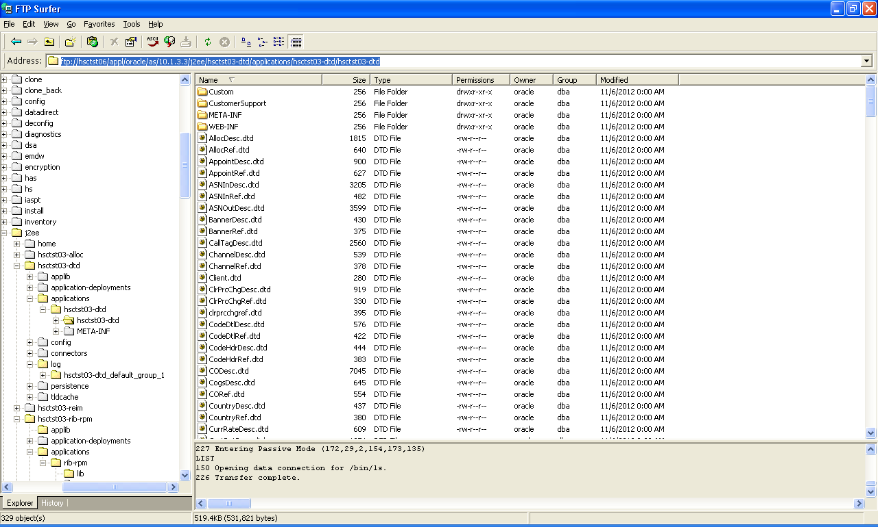
RIB DTD Schema files
Notes:
Talk about the Life cycle of a product and explain the below terms
Item
Supplier
Warehouse
Store
Price
Cost
Promotion

Slide 16
RIB Hospital
RIB Hospital Tables
  RIB_MESSAGE
  RIB_MESSAGE_FAILURE
Notes:
Talk about the Life cycle of a product and explain the below terms
Item
Supplier
Warehouse
Store
Price
Cost
Promotion

Slide 17
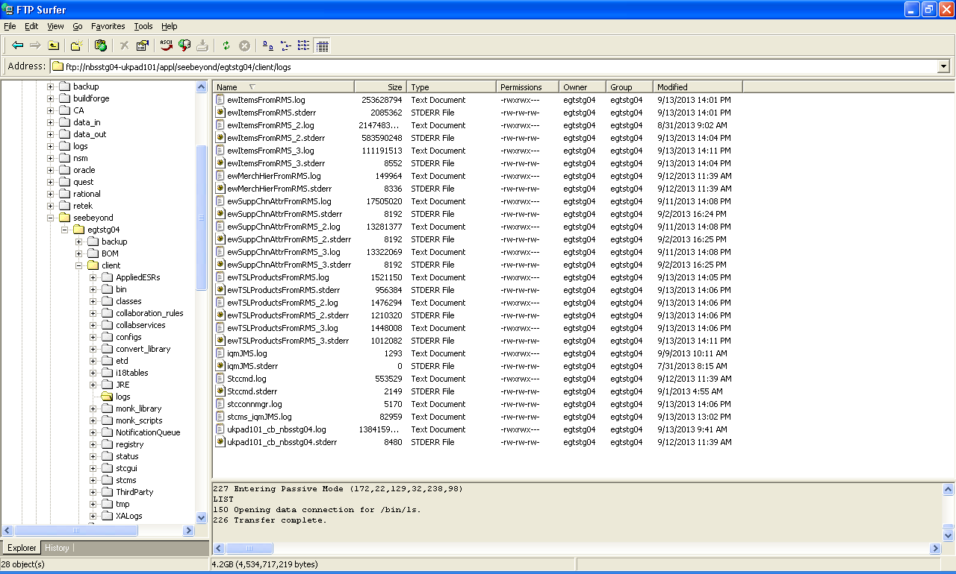
RIB Logs
Notes:
Talk about the Life cycle of a product and explain the below terms
Item
Supplier
Warehouse
Store
Price
Cost
Promotion

Slide 18
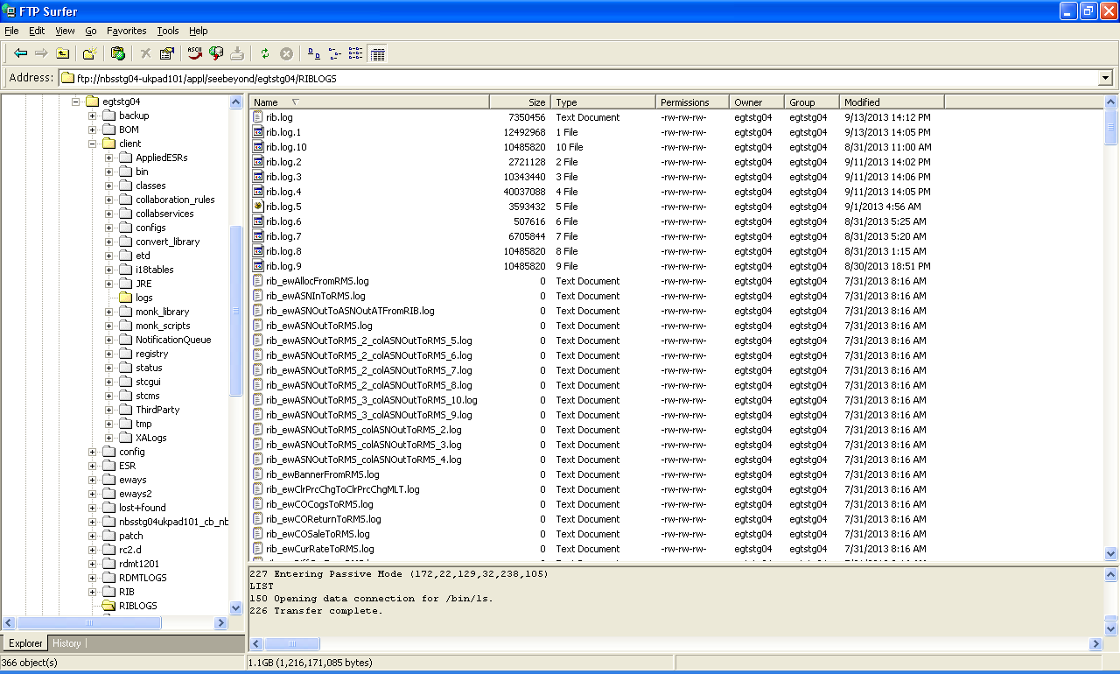
RIB Logs
Notes:
Talk about the Life cycle of a product and explain the below terms
Item
Supplier
Warehouse
Store
Price
Cost
Promotion

Slide 19
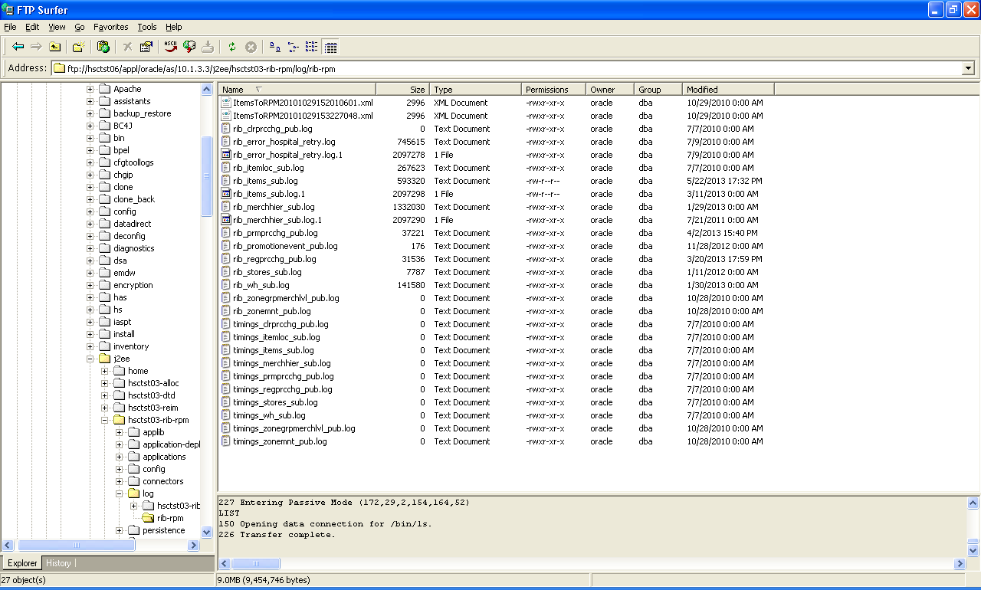
RIB for RPM Logs
Notes:
Talk about the Life cycle of a product and explain the below terms
Item
Supplier
Warehouse
Store
Price
Cost
Promotion

Slide 20
Thankyou

